Slide 1
COVID DATA ANALYSIS IN AWS

Slide 2
Objective
To perform data analysis and visualization on Covid data using ETL tools.
To perform data analysis on Covid data and extract the meaningful information from the dataset which will help in taking quick and informed decision.

Slide 3
TECHNOLOGIES USED
AWS Glue
DataCatalog
Redshift
AWS S3
Crawler
AWS Lambda
Spark with Python
Spark with Scala

Slide 4
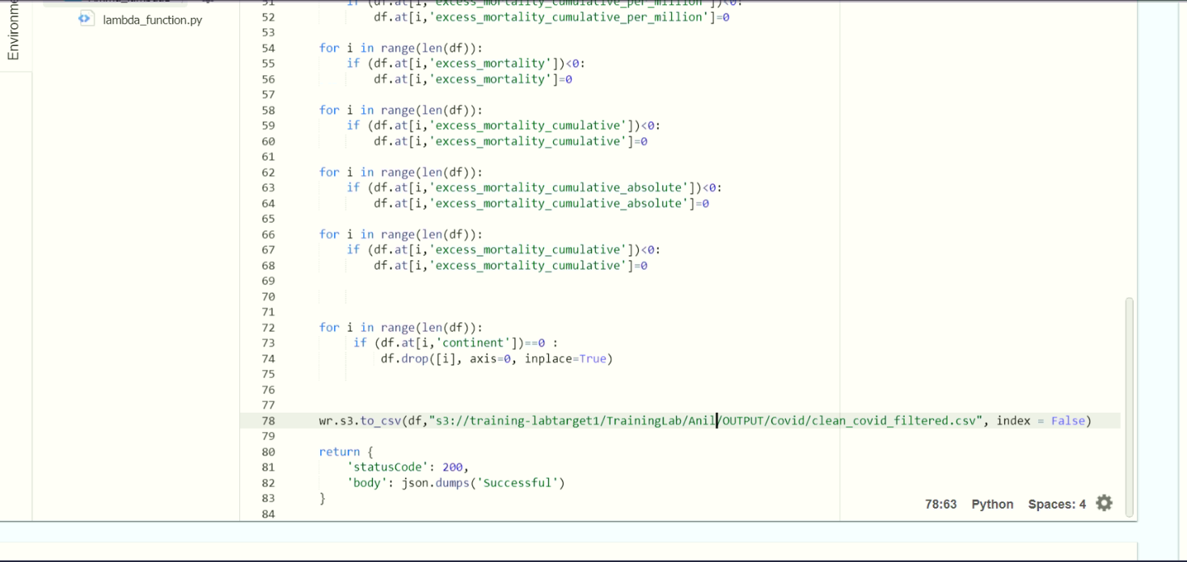
Problem Statements
Clean and transform data for processing

Slide 5
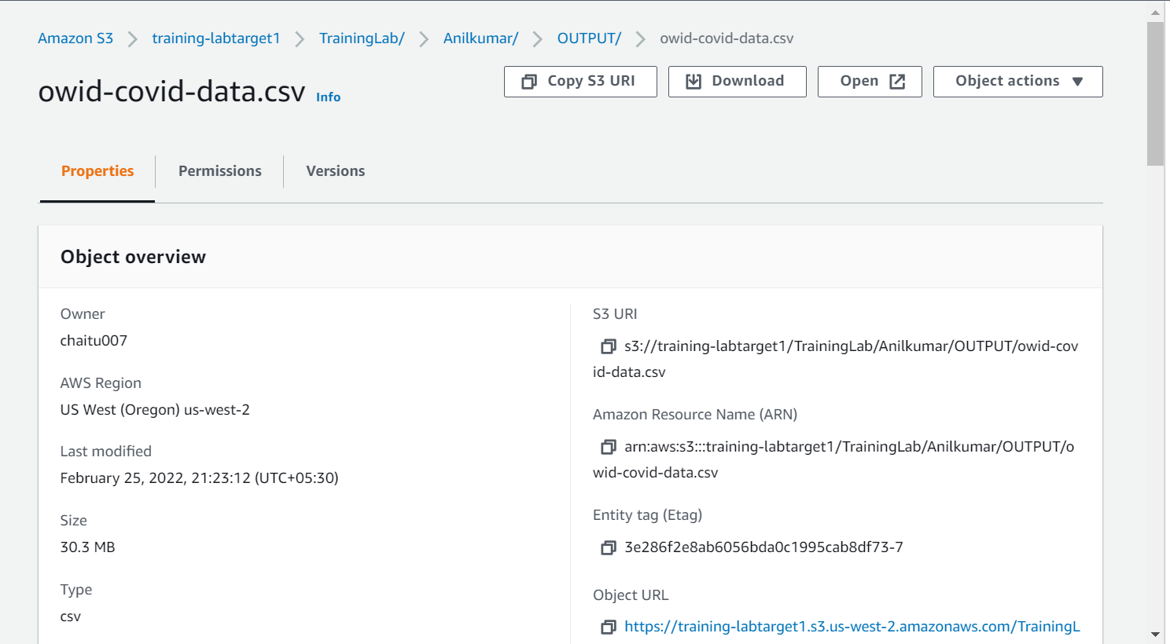
Cleaned data stored in S3 bucket :-

Slide 6
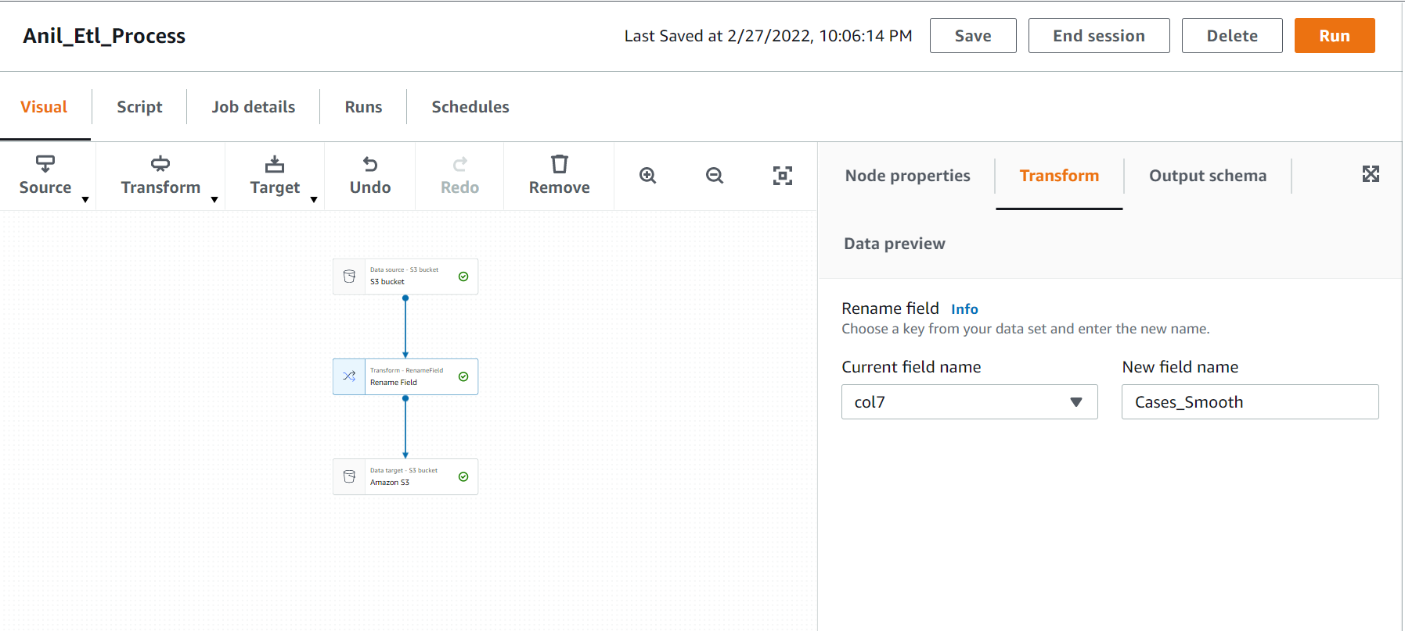
ETL Operation on DataSet

Slide 7
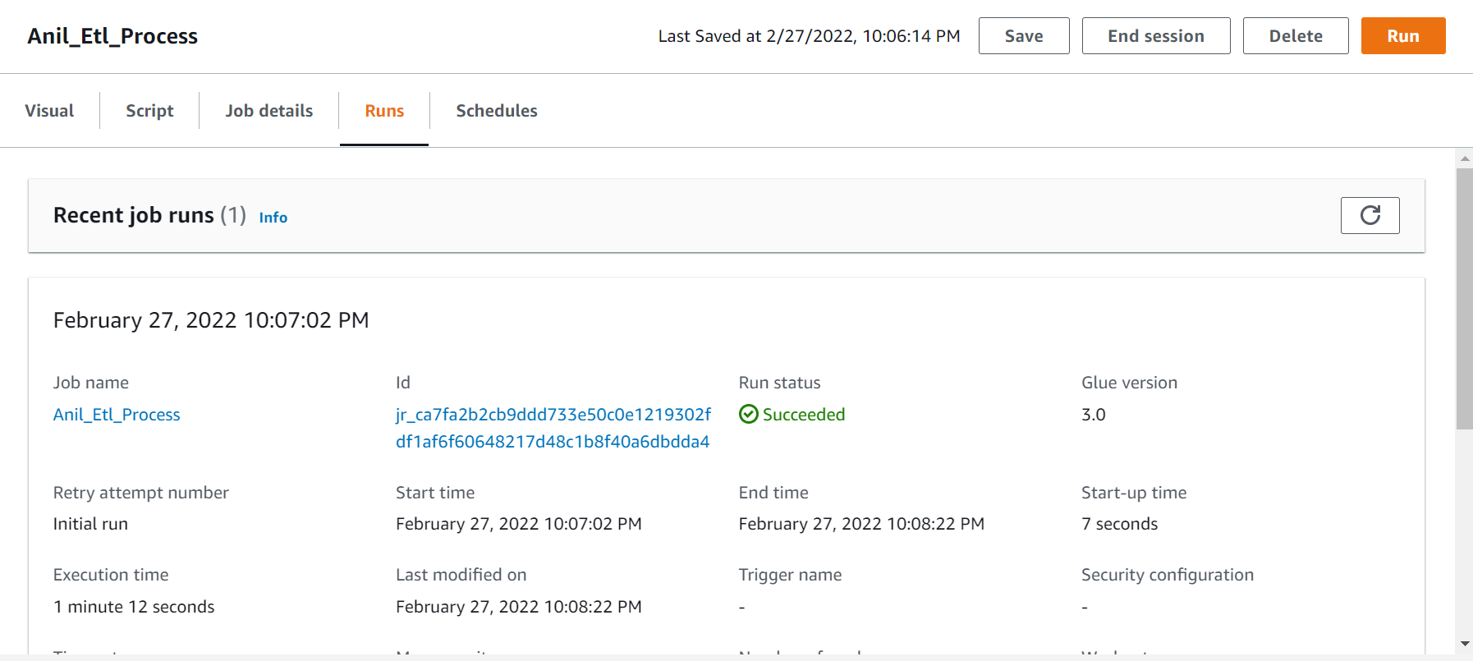
Result of ETL Process

Slide 8
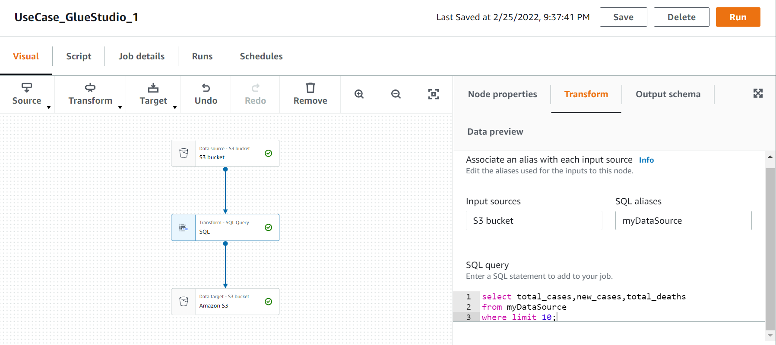
Display total cases ,new cases ,recovered cases and deaths.

Slide 9
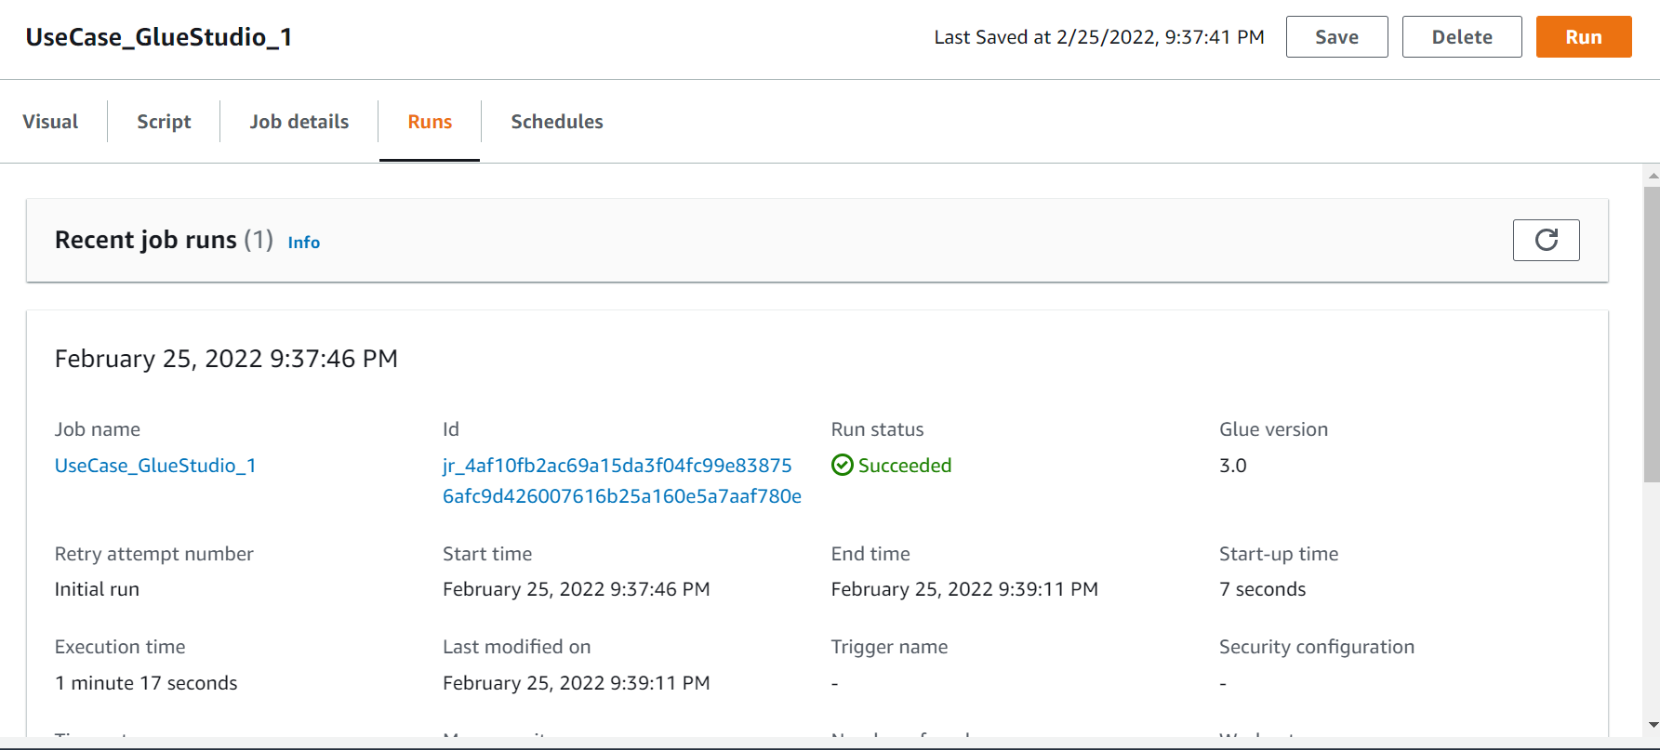
Result of Query.

Slide 10
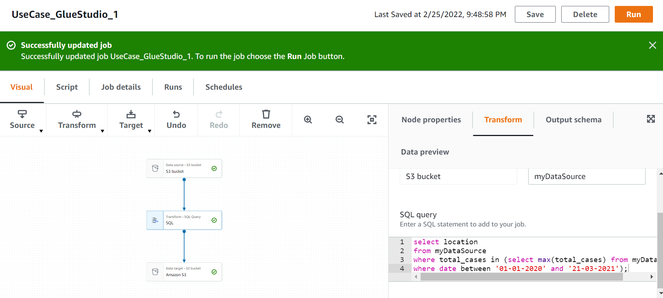
Which country in Distinct WHO region highest cases in till date.

Slide 11
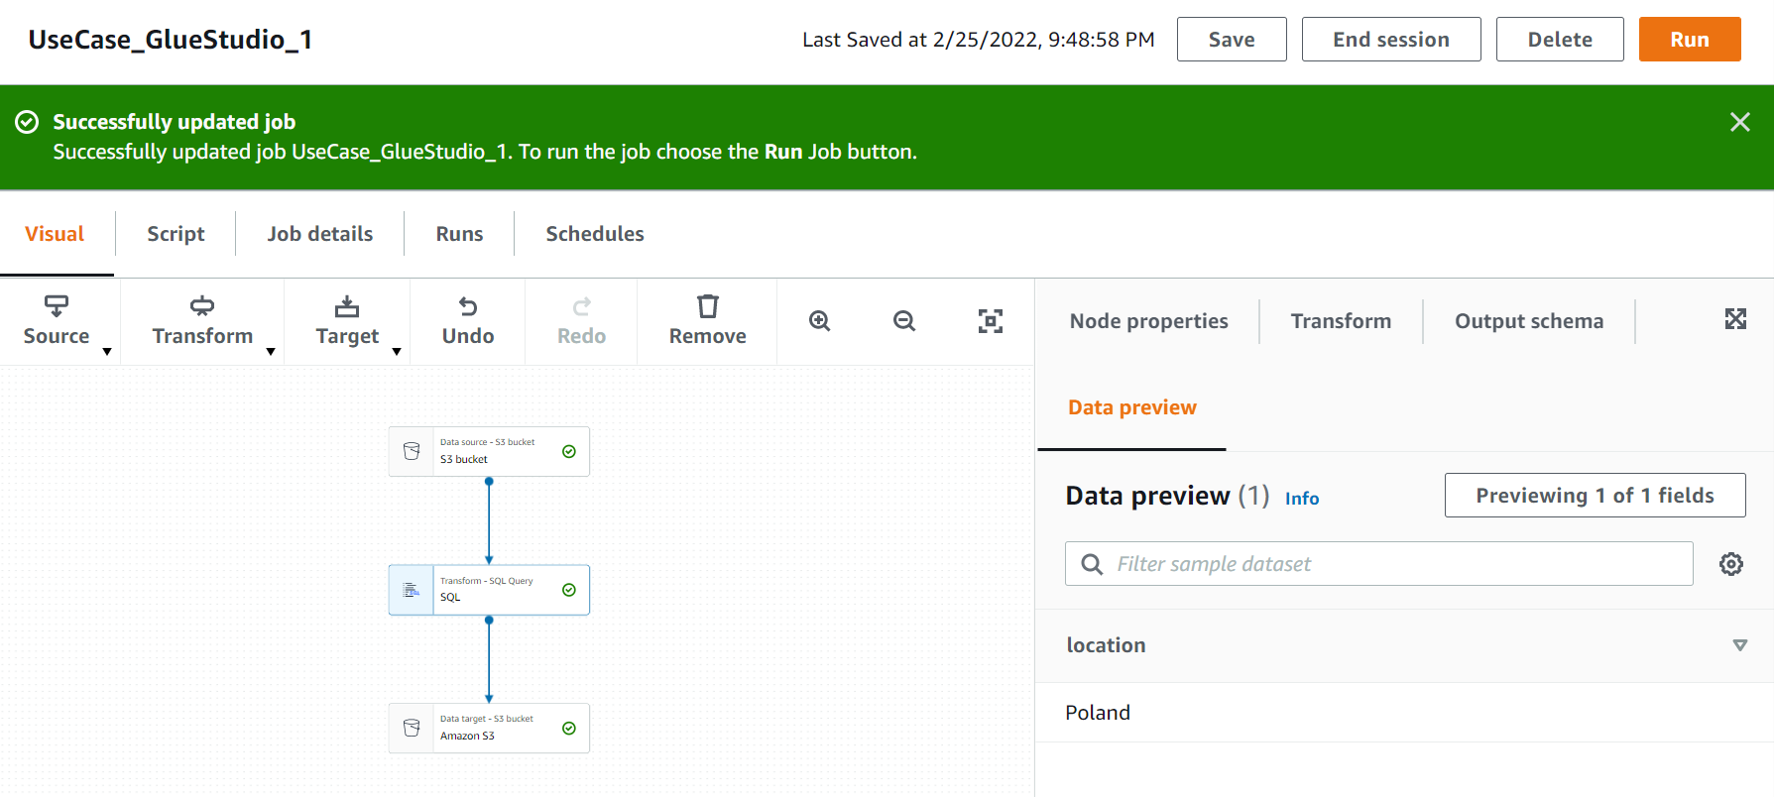
Result Of the Query

Slide 12
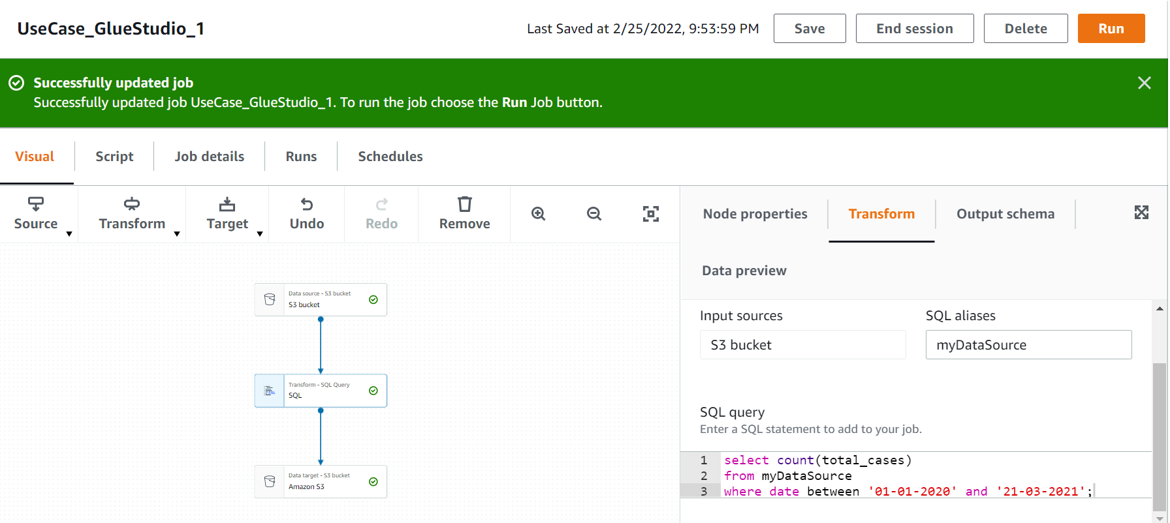
Total no of confirmed cases over between a certain date.

Slide 13
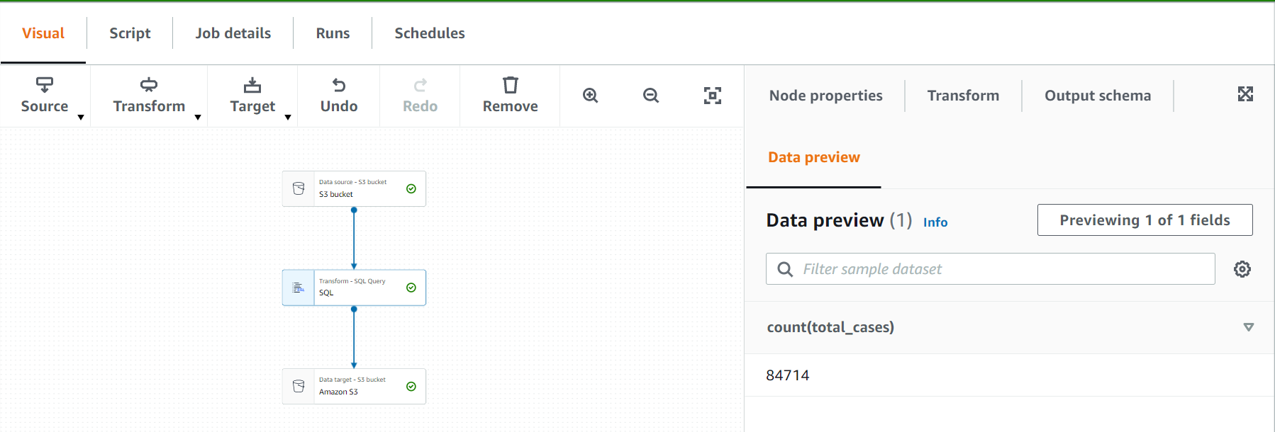
Result of Query.

Slide 14
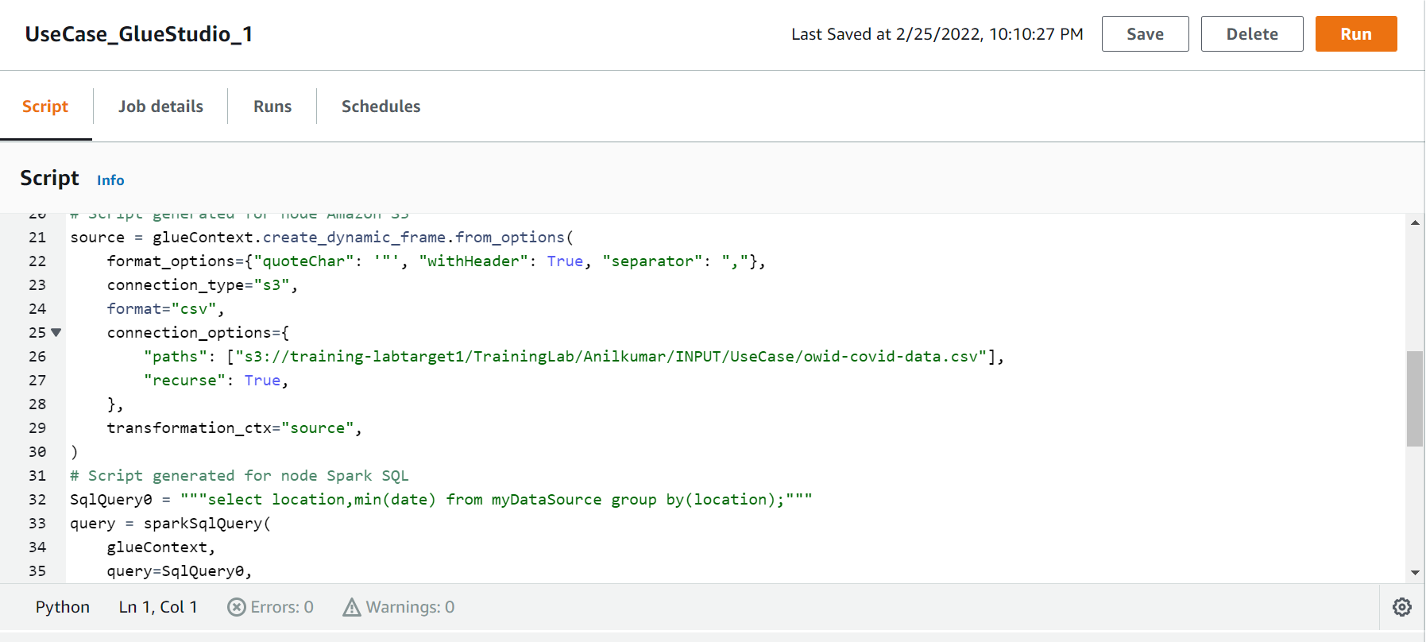
Date of first confirmed case in a particular region
Using Spark with Scala

Slide 15
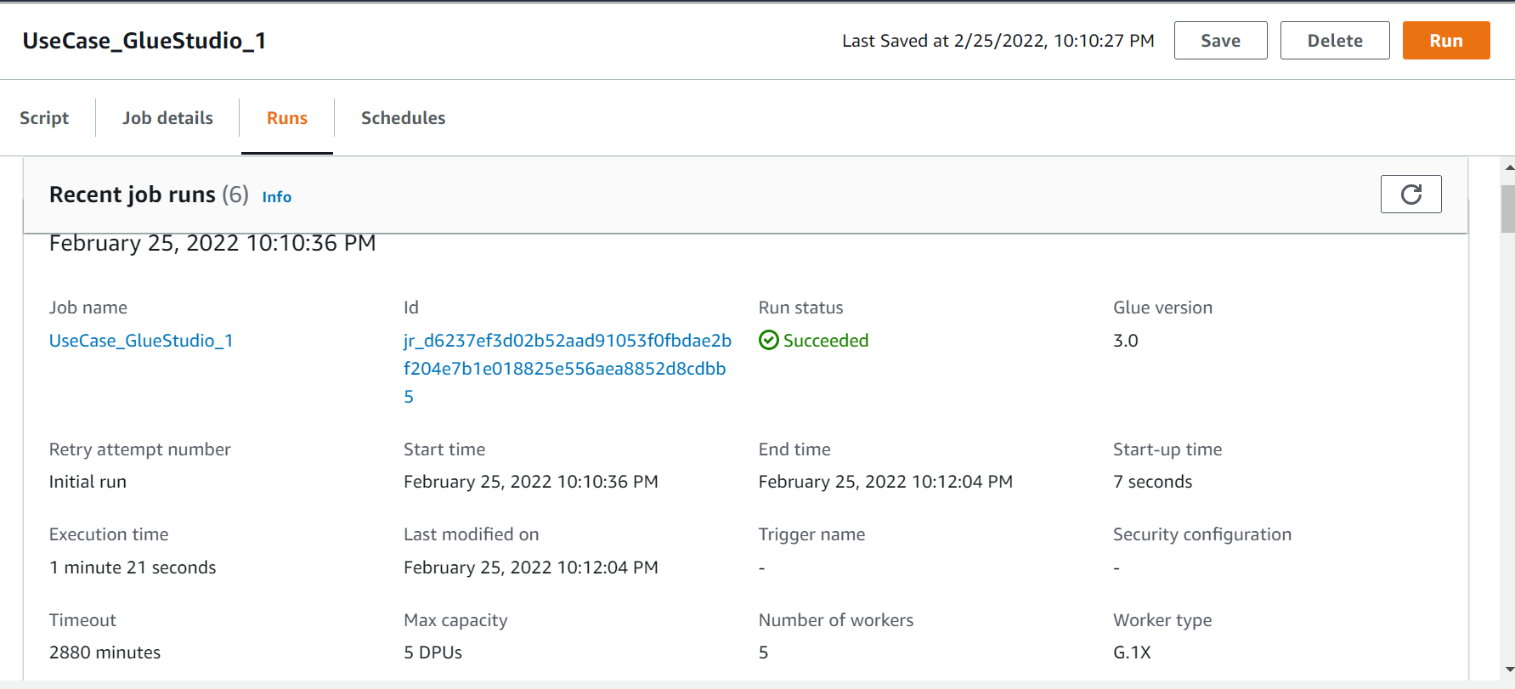
Result Of Pyspark Query

Slide 16
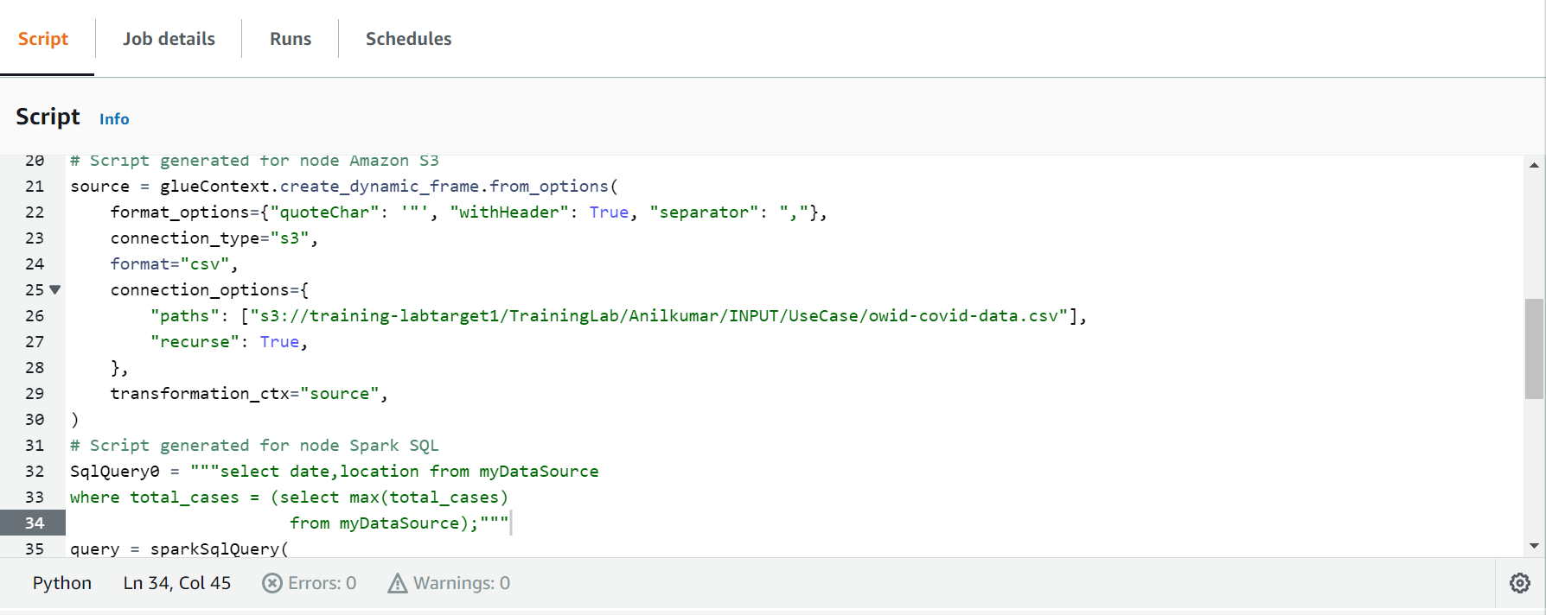
Date of first confirmed case in a particular region

Slide 17
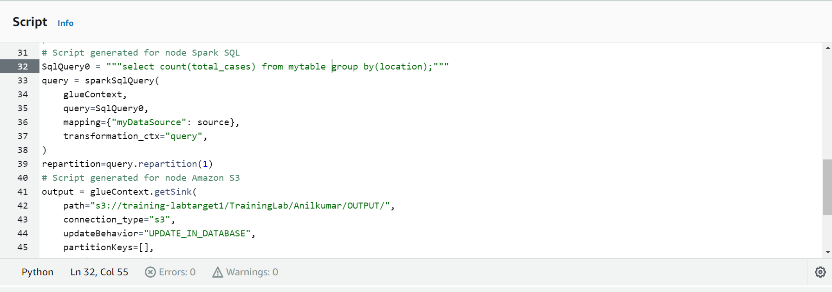
Date on which max no. cases were reported in a country.

Slide 18
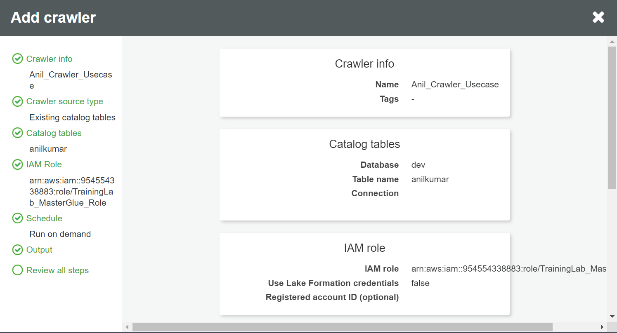
Using Crawler

Slide 19
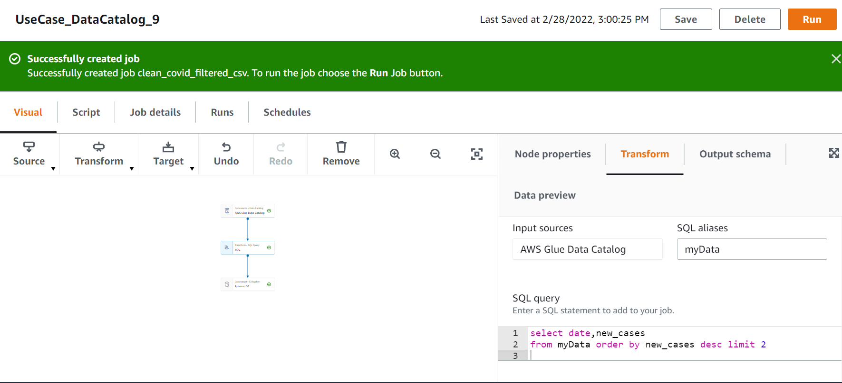
Crawler Using

Slide 20
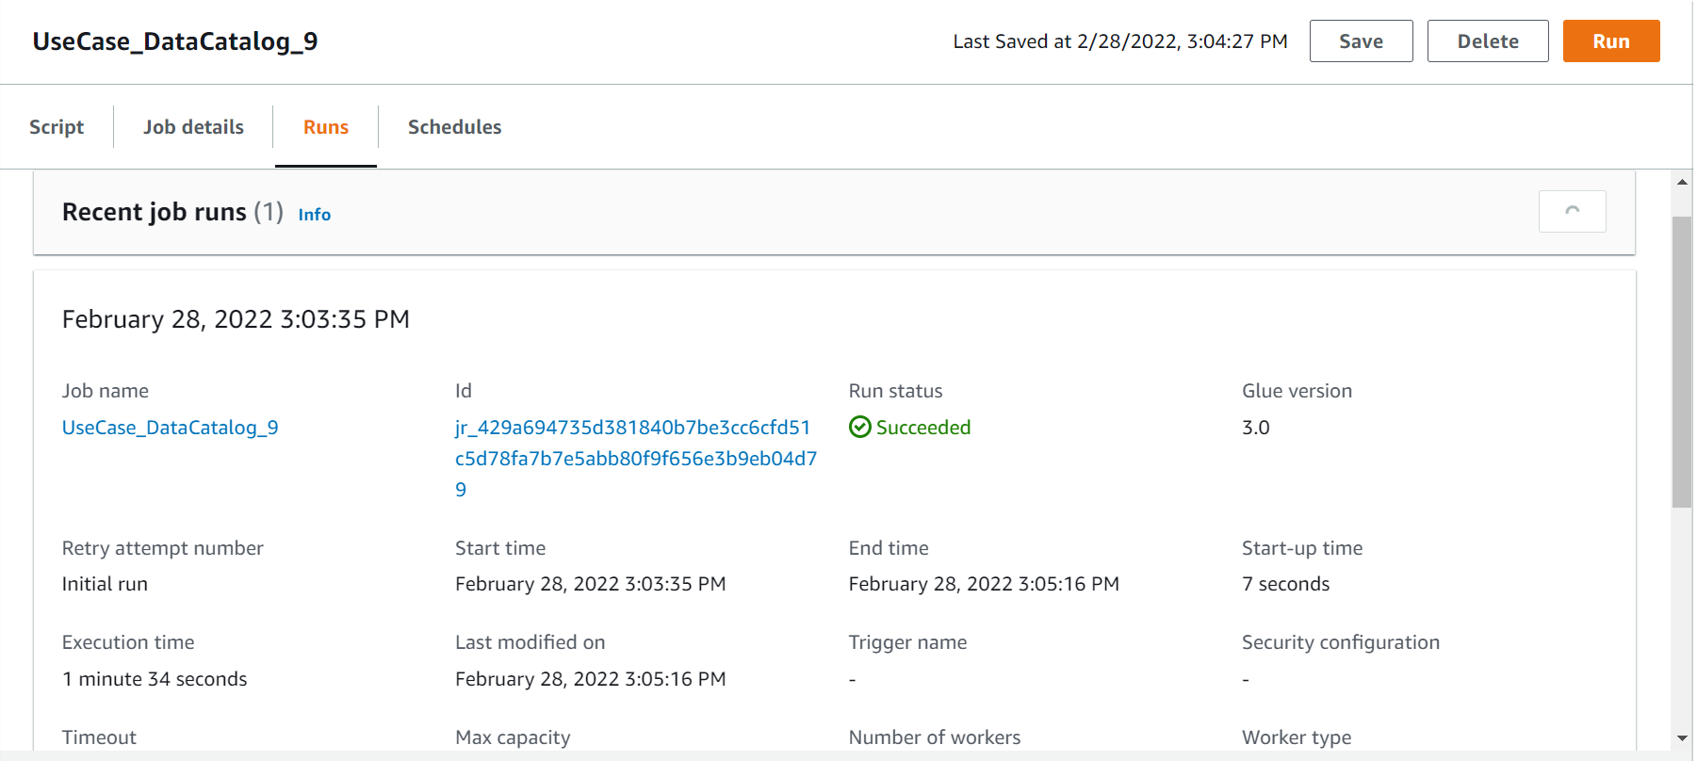
OutPut:-

Slide 21
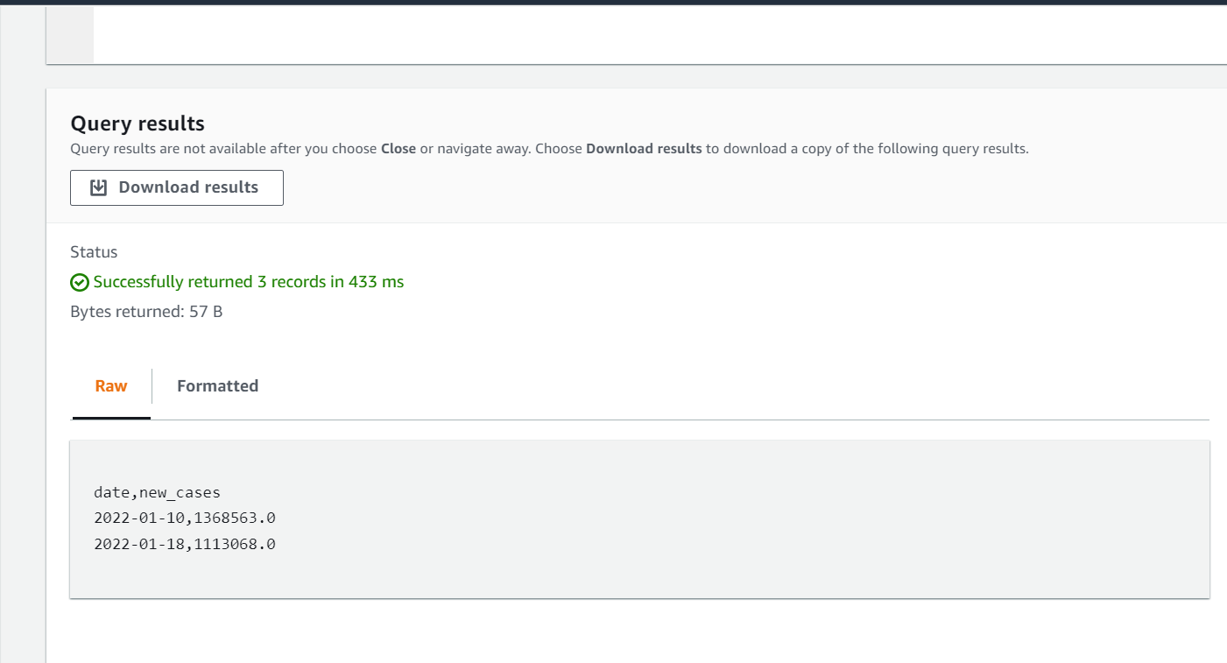
Result

Slide 22
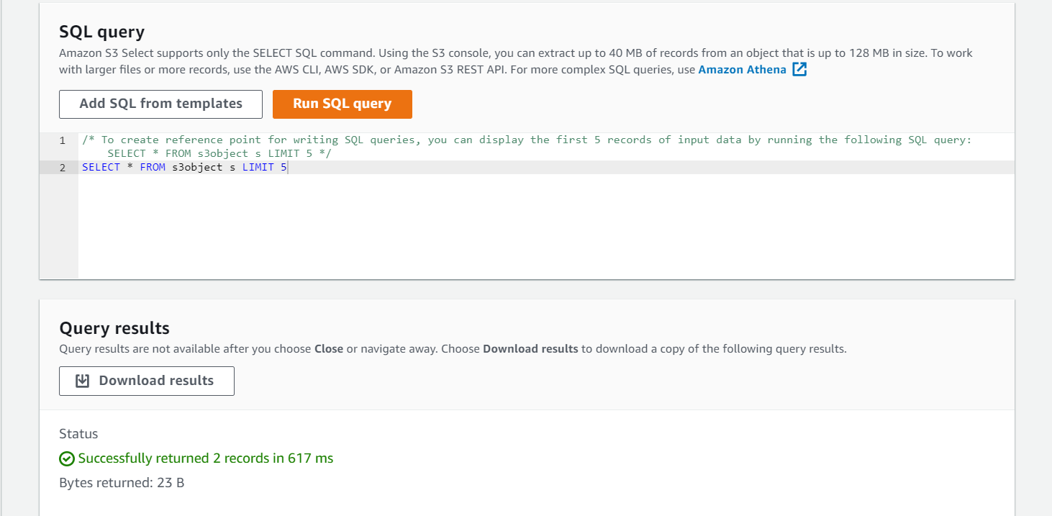
Date of first confirmed case in a particular region.

Slide 23
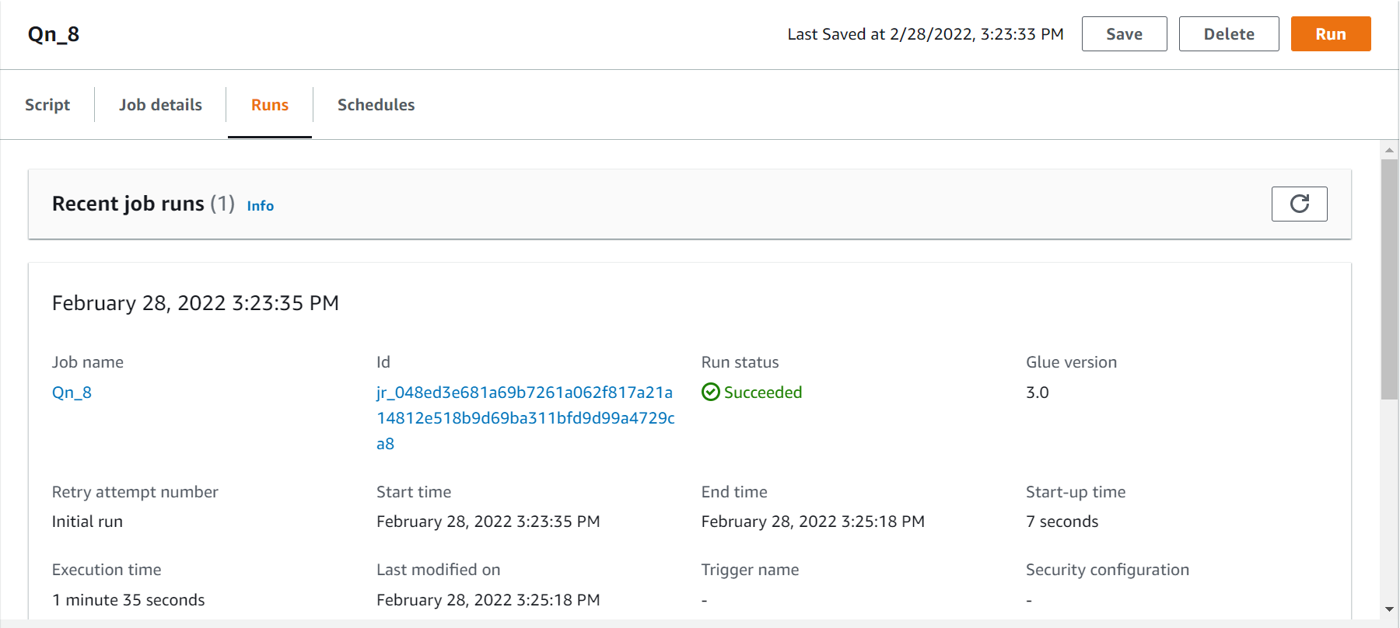
Running status

Slide 24
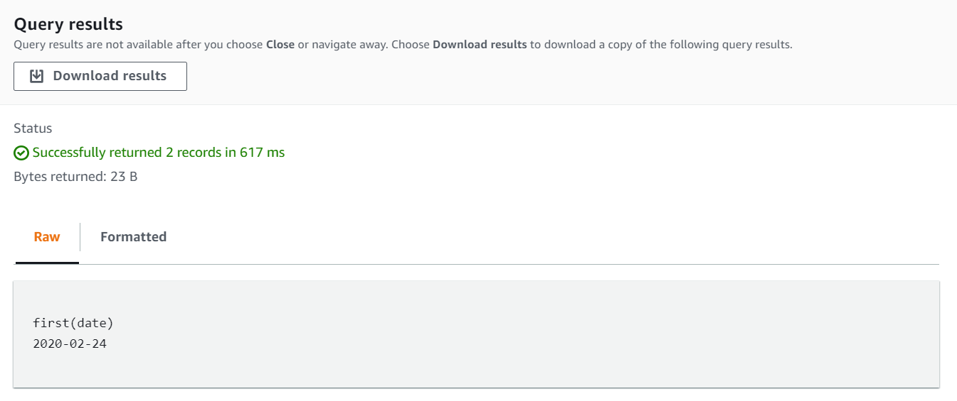
Result

Slide 25
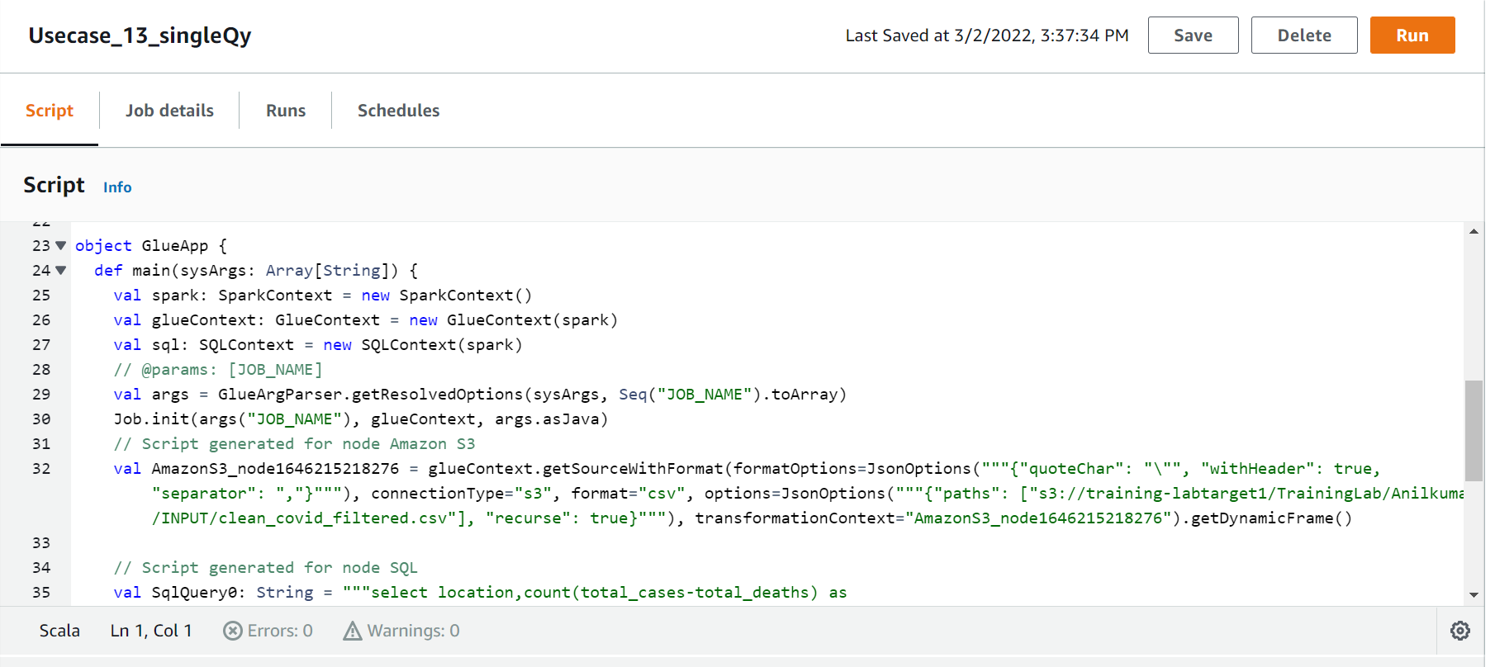
No. of active cases vs critical cases of a country.

Slide 26
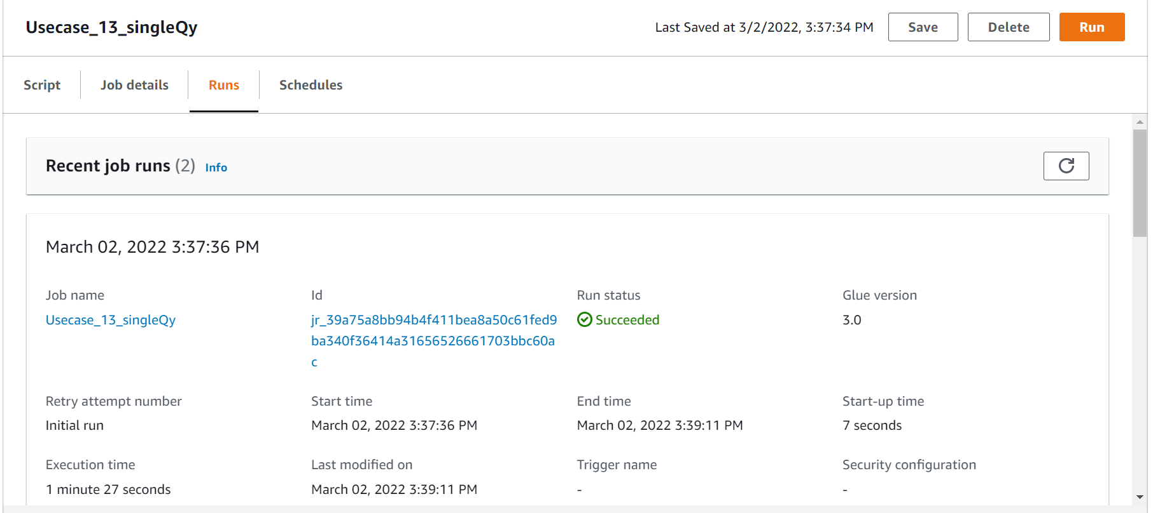
Running Status

Slide 27
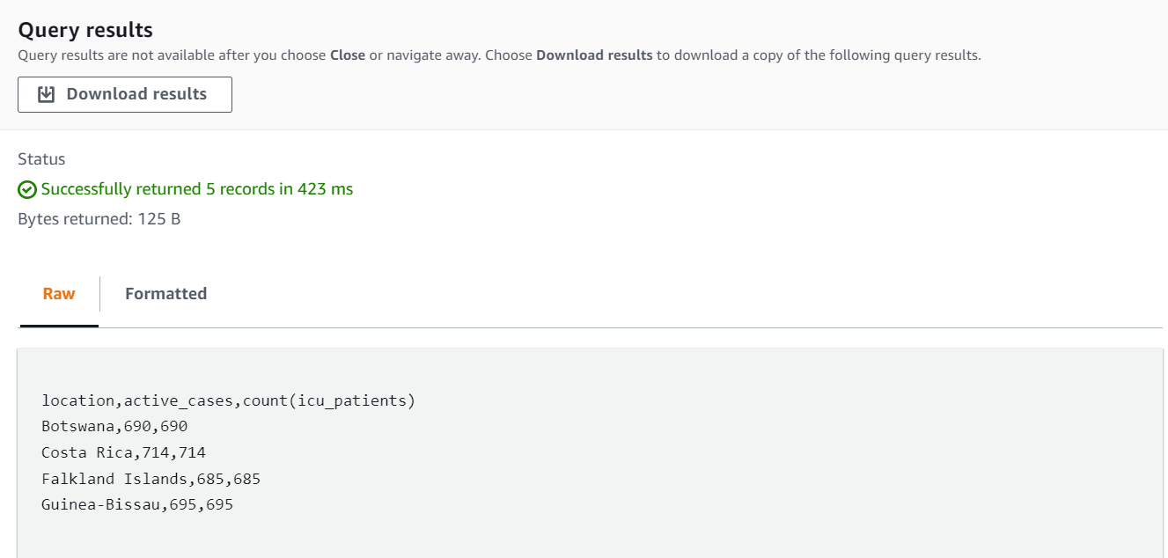
OUTPUT in S3

Slide 28
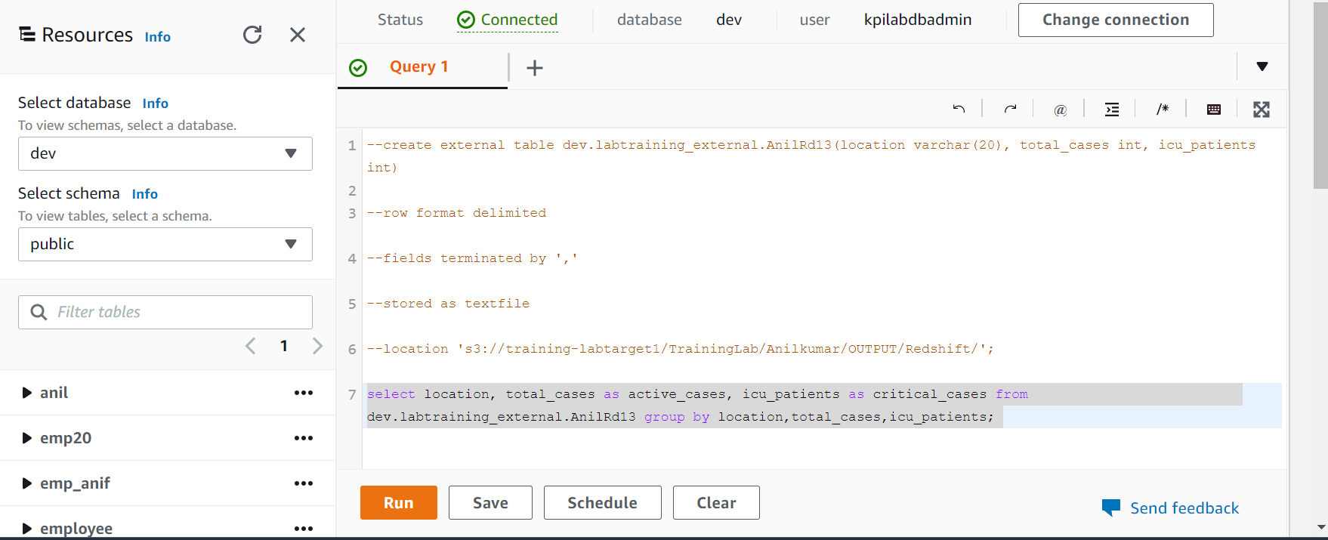
No. of active cases vs critical cases of a country.
RedShift

Slide 29
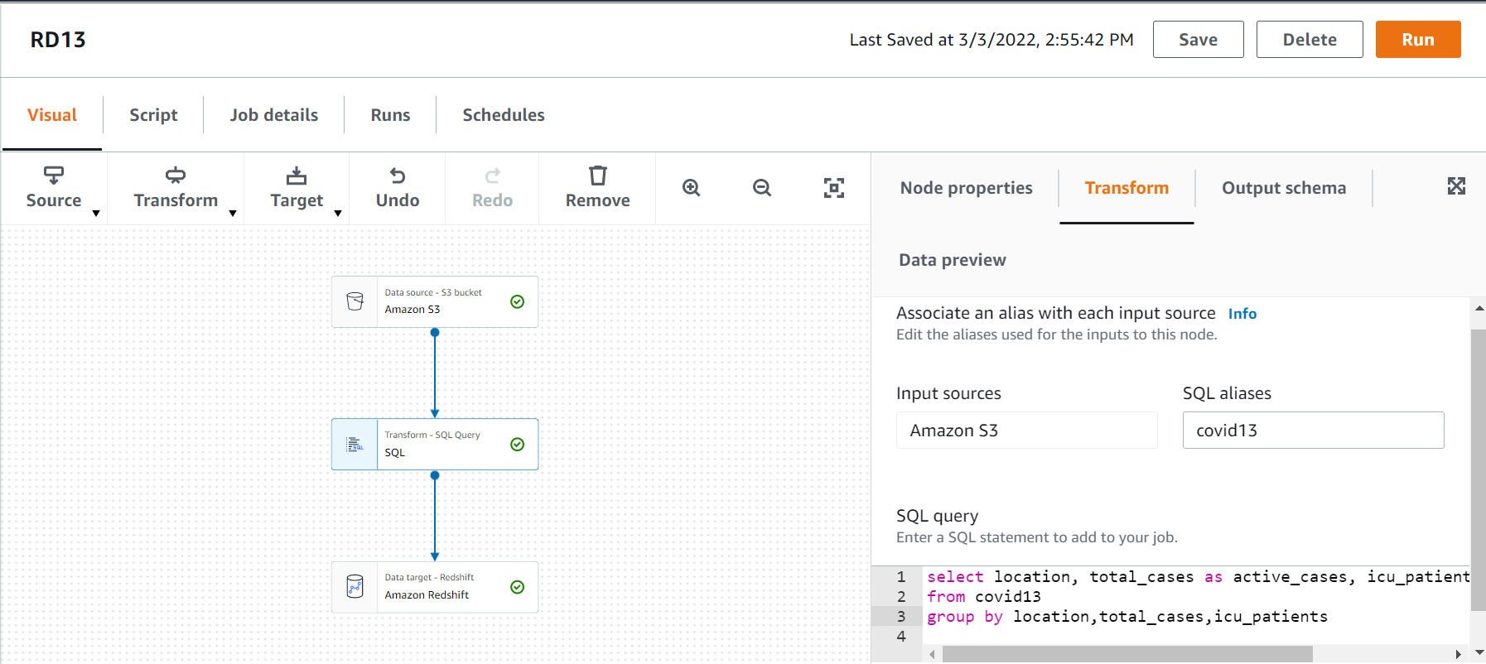
Output of RedShift

Slide 30
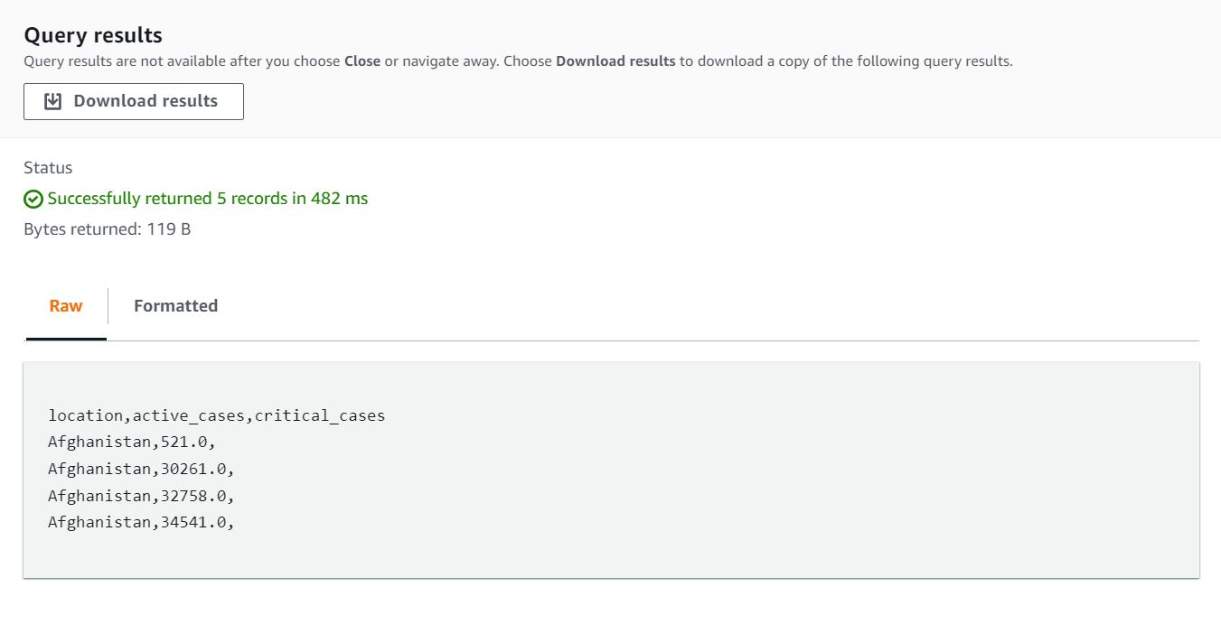
OUTPUT

